Slide 1


Microsoft® Lync™ 2010
Delegate Training

Slide 2
Objectives
In this course you learn how to:
Set up Delegate Access by using Outlook
Set up Delegate Access in Lync
Schedule an Online Meeting on Behalf of Your Manager
Initiate a Meet Now on Behalf of Your Manager
Start a Conference Call on Behalf of Your Manager

Slide 3
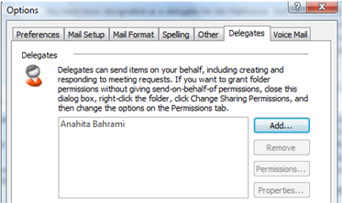
Set up Delegate Access by Using Outlook 2007
Click Tools, and then click Options.
Click Options.
In the Options window, click the Delegates tab.
Click Add, and then type the name of the person whom you want to designate as your delegate.
Click Add, and then click OK.
In the Delegate Permissions dialog box, under the calendar option, select Editor rights.
To send a message to notify the delegate of the changed permissions, select the Automatically send a message to delegate summarizing these permissions check box.
Click OK.
Note: These steps must be performed by the manager.
BACK TO OBJECTIVES

Slide 4
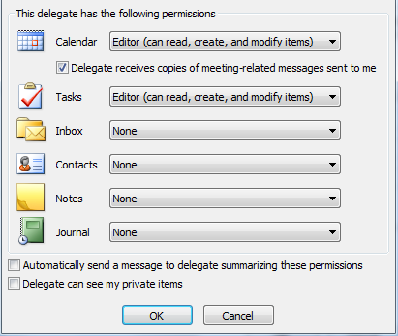
Set up Delegate Access by Using Outlook 2010
Click the File tab.
Click Account Settings, and then
click Delegate Access.
Click Add.
Type the name of the person whom you
want to designate as your delegate.
Click Add, and then click OK.
In the Delegate Permissions dialog box,
under the calendar option, select
Editor rights.
To send a message to notify the delegate of
the changed permissions, select the Automatically send a message to delegate summarizing these permissions check box.
Click OK.
Note: These steps must be performed by the manager.
BACK TO OBJECTIVES

Slide 5
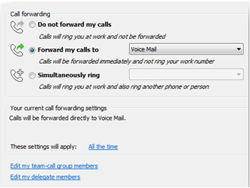
Set up Delegate Access in Lync
  Open Microsoft Lync.
  Click the down arrow next to the Options button, click Tools, and then click Call-Forwarding Settings.
  Click Edit my delegate members, and then click Add to select the delegates.
Note: These steps must be performed by the manager.
BACK TO OBJECTIVES

Slide 6
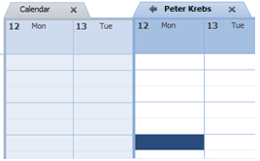
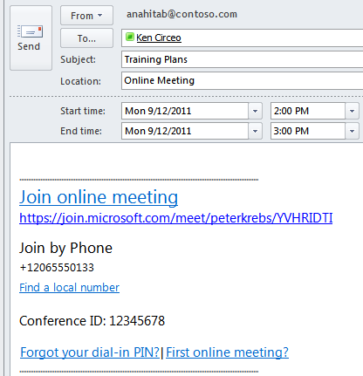

Schedule on Behalf of Your Manager
Open Outlook and locate your manager’s calendar.
Select a time, and then click New Online Meeting (in Outlook 2010) or Online Meeting (in Outlook 2007) on the Outlook toolbar.
When the invitation opens, notice that the meeting URL contains your manager’s alias.
Also notice your manager’s name In Shared Folder at the bottom of the invitation.
Type a subject and add the invitees.
Select
a Time
Manager’s Alias
Shared Folder
BACK TO OBJECTIVES

Slide 7
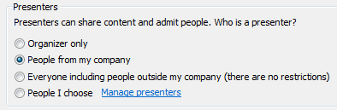
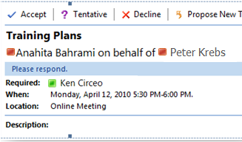
Customize Your Meeting Options
Change the default meeting options.
Click Meeting Options on the Outlook ribbon to customize Access Level, Presenters, and Audio options.
When the Meeting Options window opens, select the check box next to Customize access and presenters for this meeting.
Under the Access and Presenter section, select the options as appropriate.
TIP: You can click Remember Settings to save the options as default for your manager.
When you have finished scheduling the meeting, send the invitation to the participants.
Select Presenters
Invitation to attendees
Note: The invitation includes your name, your manager’s name, and the meeting information, including the meeting link and audio information.
BACK TO OBJECTIVES

Slide 8
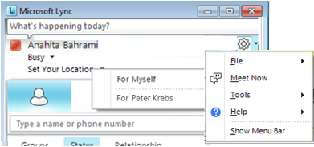
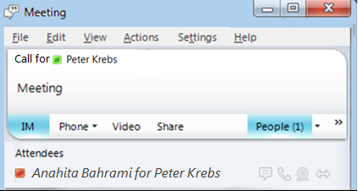
Meet Now on Behalf of Your Manager
To start an unscheduled meeting by using the Meet Now command, do the following:
Open Microsoft Lync, click the Options button, and then click Meet Now. You can also click Meet Now on the menu bar.
Select For <your manager>.
An online meeting opens for your manager.
Click the People menu and invite your manager and any other contacts.
BACK TO OBJECTIVES

Slide 9
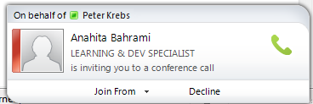
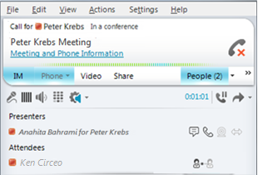
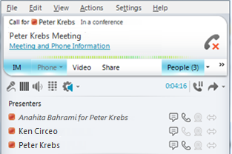
Join the Meet Now Meeting
People that you invite to the meeting receive a notification and can join by clicking the notification.
1
Pop-up invitation
2
Connecting to the meeting
3
Participants connected
BACK TO OBJECTIVES

Slide 10
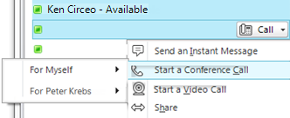
Start a Conference Call on Behalf of Your Manager
Open Microsoft Lync and select the contacts to join the conference call.
Note: Hold Down The CTRL Key when you select multiple contacts.
Right-click the selection and point to Start a conference call.
Select For <your manager>.
Select Lync or the number to be used to start the conference call from.
BACK TO OBJECTIVES

Slide 11
Review
This course covered the following:
Set up Delegate Access by using Outlook
Set up Delegate Access in Lync
Schedule an Online Meeting on Behalf of Your Manager
Initiate a Meet Now on Behalf of Your Manager
Start a Conference Call on Behalf of Your Manager
BACK TO OBJECTIVES

Slide 12


© 2010 Microsoft Corporation. All rights reserved. Microsoft, Exchange ActiveSync, Excel, Lync, Outlook, PowerPoint, SharePoint, SQL Server, Windows, Windows Live, Windows Mobile, Windows Server, and other product names are or may be registered trademarks and/or trademarks in the United States and/or other countries/regions. The information herein is for informational purposes only and represents the current view of Microsoft Corporation as of the date of this presentation. Because Microsoft must respond to changing market conditions, it should not be interpreted to be a commitment on the part of Microsoft, and Microsoft cannot guarantee the accuracy of any information provided after the date of this presentation. MICROSOFT MAKES NO WARRANTIES, EXPRESS, IMPLIED OR STATUTORY, AS TO THE INFORMATION IN THIS PRESENTATION.
BACK TO OBJECTIVES

